Slide 1
Mood board of art style
Willoughby Lenneth
Design Master Class

Slide 2
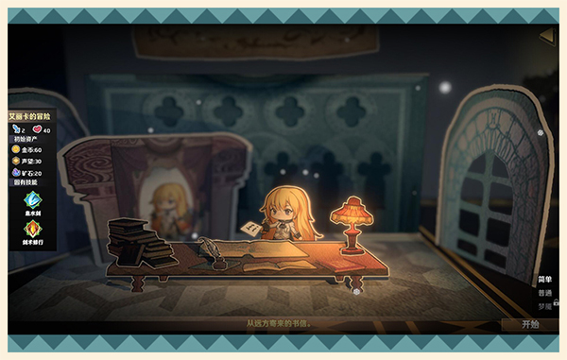
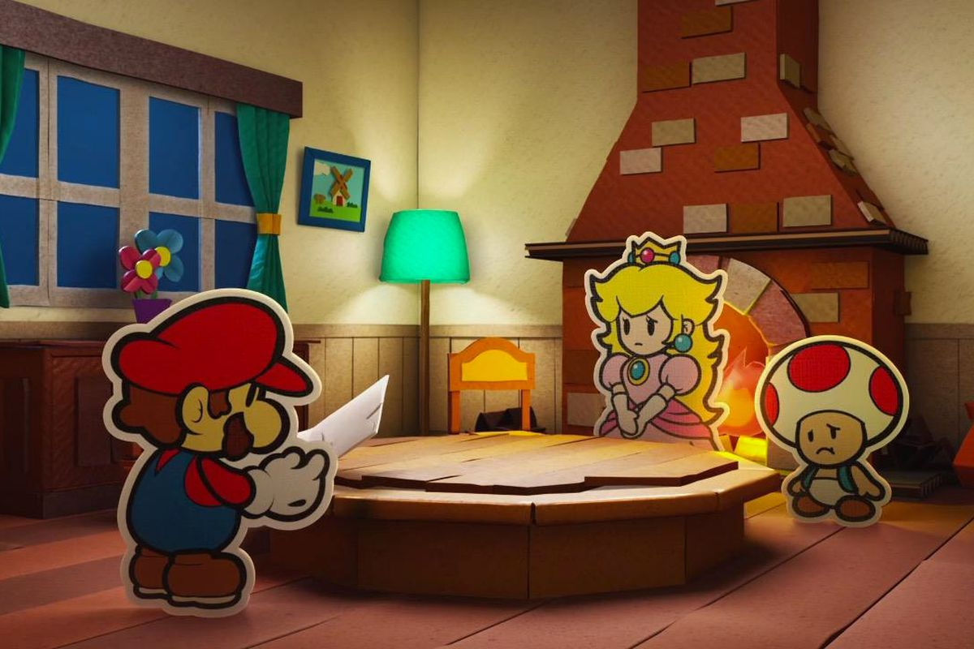
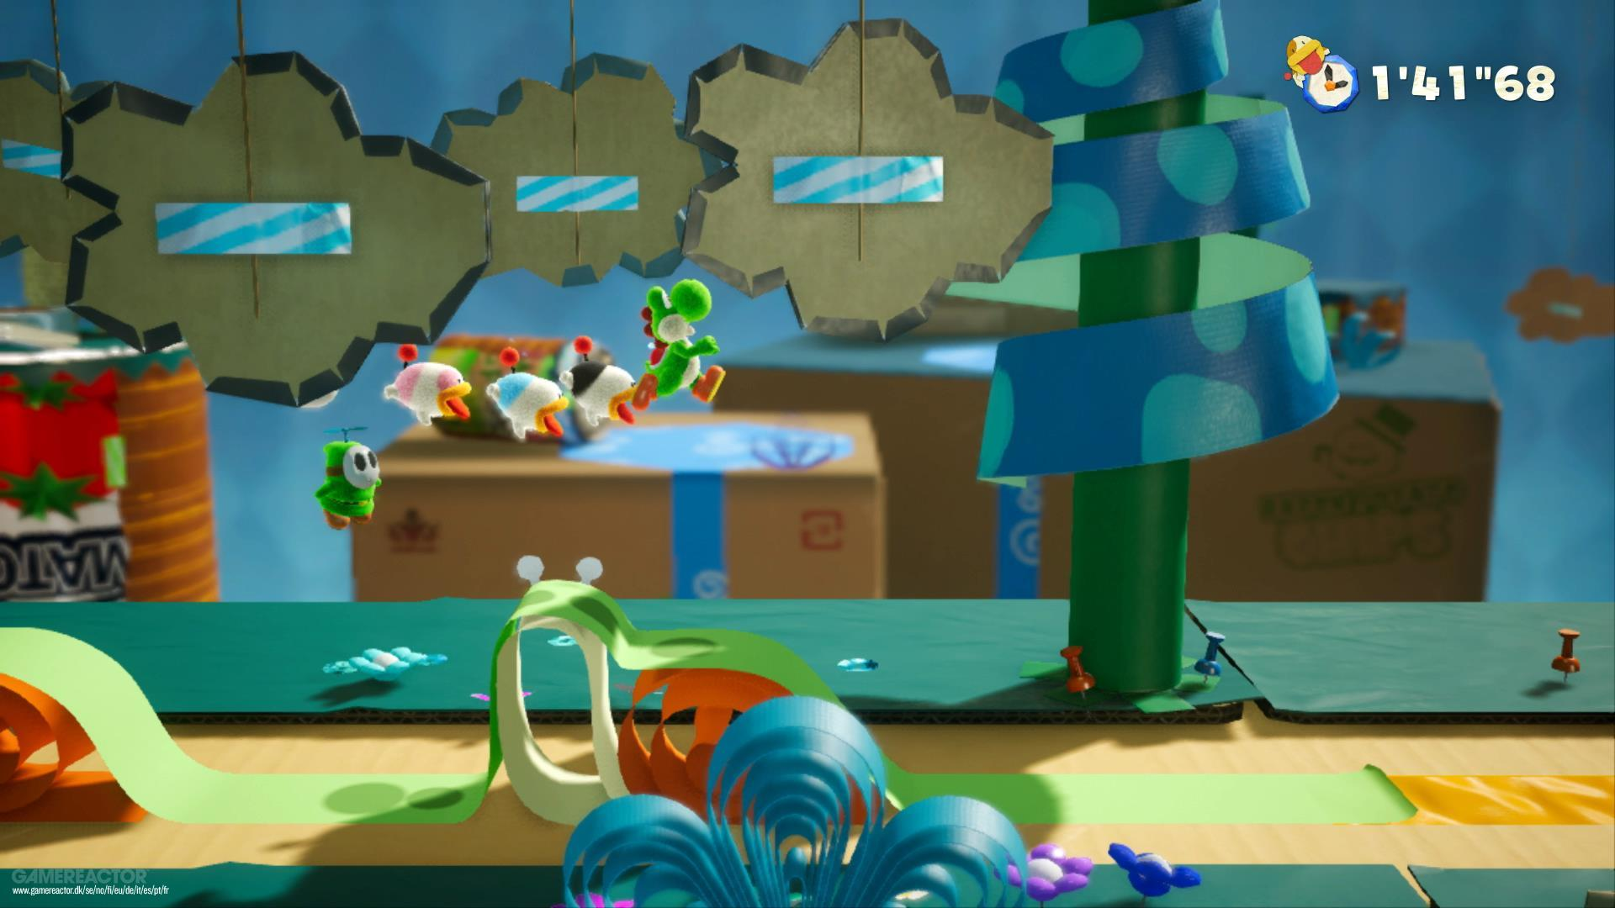
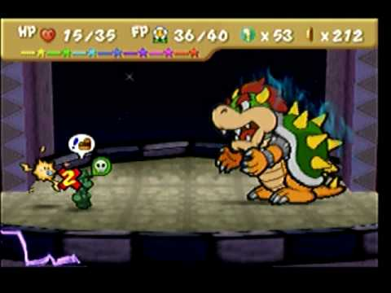
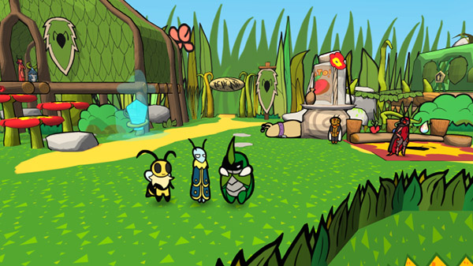
The Background
In our dialogue screens, our game will have a similar viewpoint to these images.
Some of the backgrounds shown are 3D but we are going with more of a cel shaded cartoony background, to make it look like it’s 3D when it isn’t really.
Notes:
Image References
https://www.polygon.com/2016/9/23/13028328/paper-mario-color-splash-leaks
https://gematsu.com/2019/05/adventure-rpg-bug-fables-announced-for-ps4-switch-and-pc
https://www.youtube.com/watch?v=mPasnNb9Xfg
https://skidrowcracked.com/%E7%BA%B8%E5%A2%83%E8%8B%B1%E9%9B%84-papercraft/

Slide 3
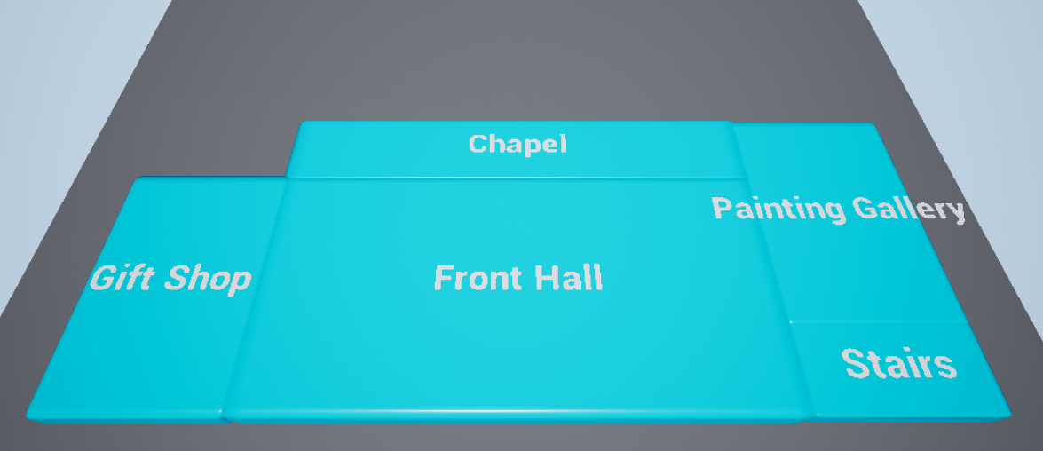
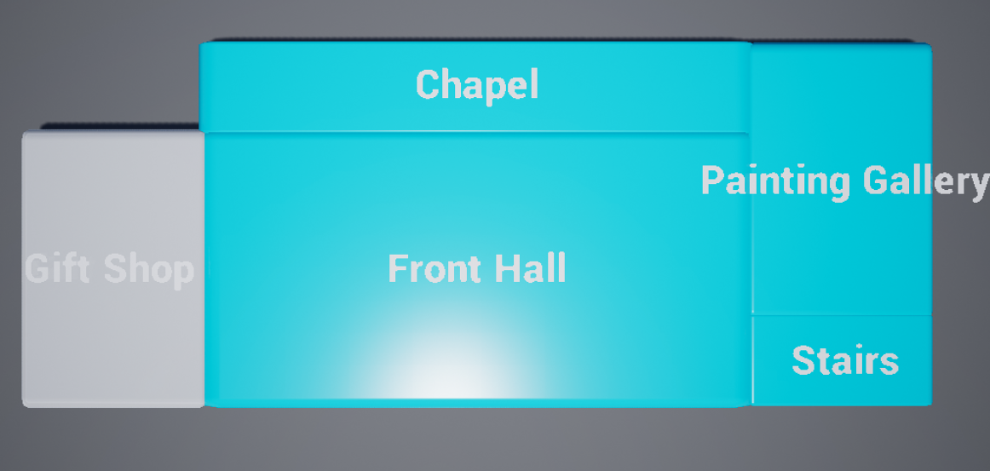
For the map we have decided to have an angled top down view.
This is a current prototype of the map view
Top down
Angled top down

Slide 4
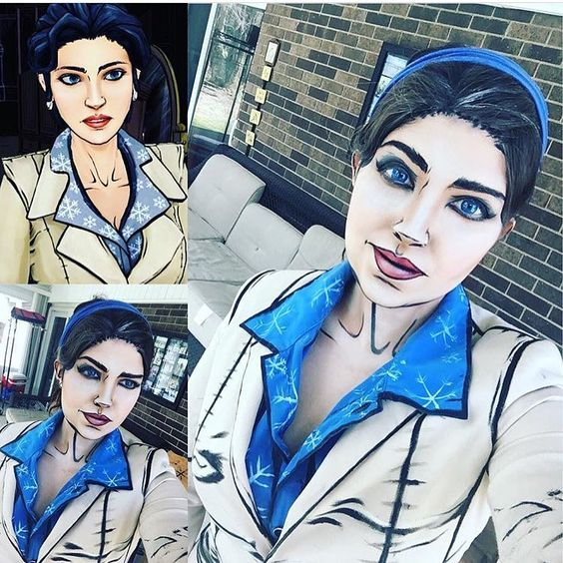
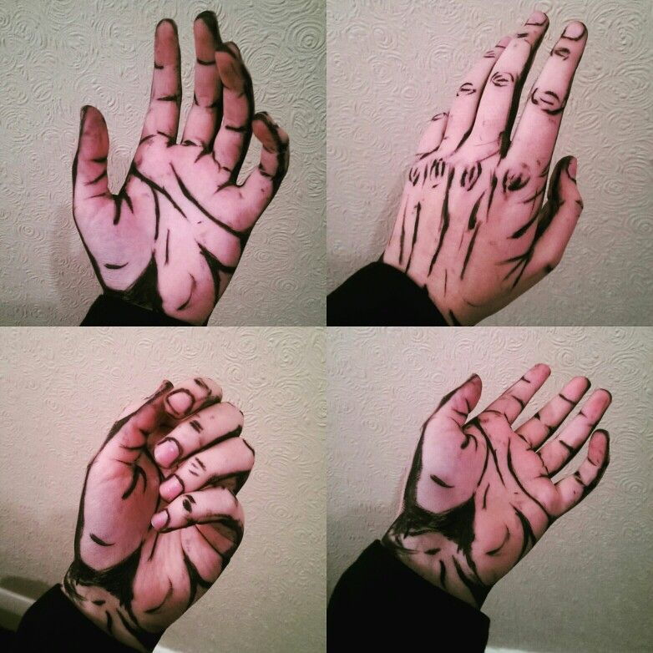
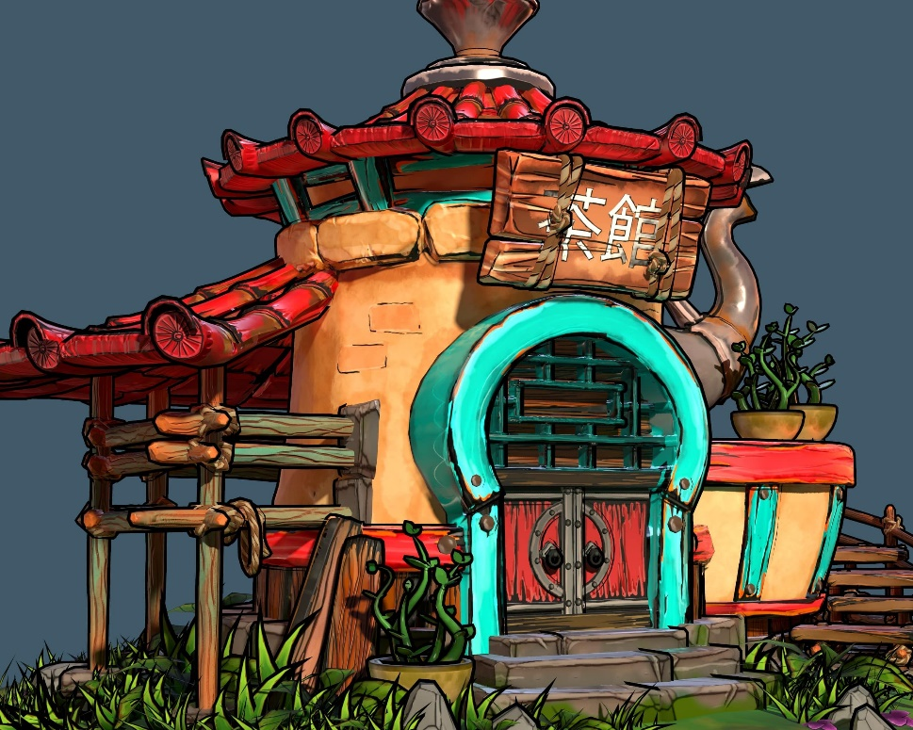
Example of cel shaded art style
This is for the background art, where we will be cel shading the images of the mansion interior.
Notes:
https://www.pinterest.com/pin/516365913519259481/
https://www.pinterest.com/pin/527132331364670264/?lp=true
https://www.pinterest.com/pin/727823989762389365/?lp=true

Slide 5
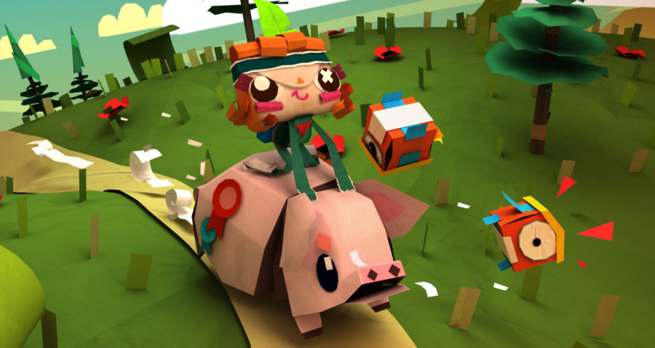

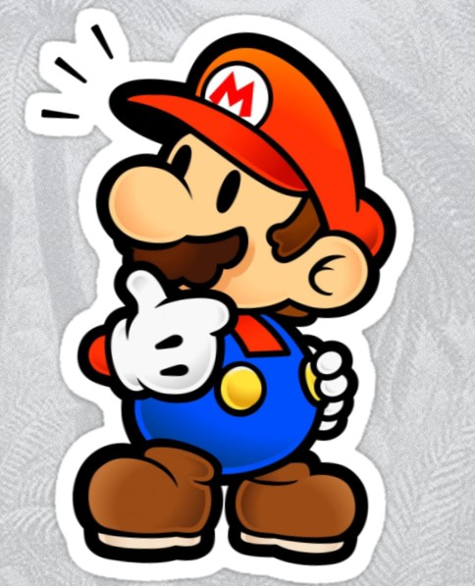
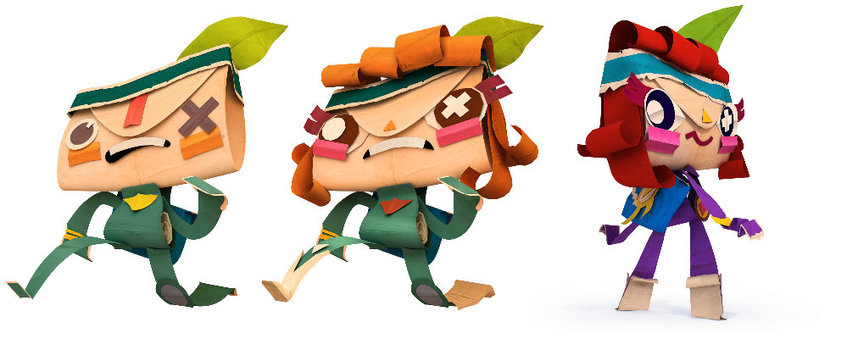
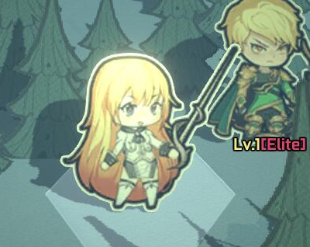
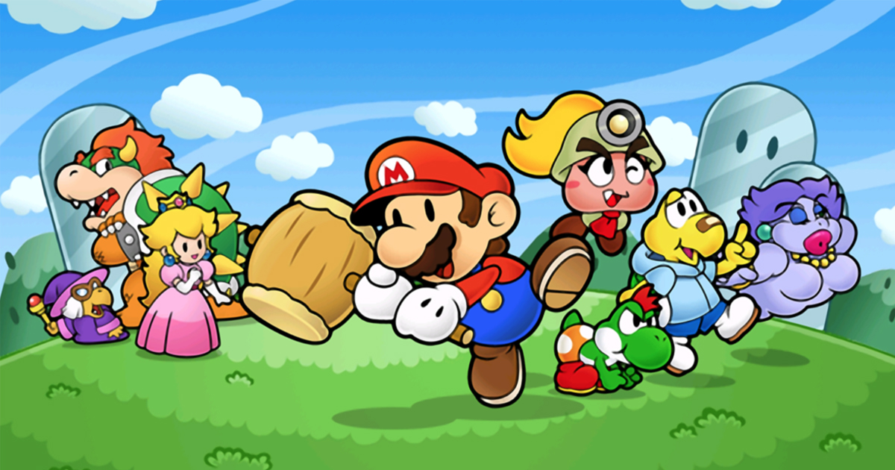

Character artstyle
For the character art style we have chosen a more cartoony 2D papercraft art style with heavy black and white borders.
Notes:
Image References
https://www.deviantart.com/fawfulthegreat64/art/Paper-Mario-Wedding-Tux-758721432
https://www.roblox.com/library/68832498/monopoly-man
https://thehardtimes.net/harddrive/nintendo-announces-all-mario-to-be-paper-by-2025/
https://www.vg247.com/2013/11/20/tearaway-the-best-reason-to-own-a-ps-vita/
https://www.neogaf.com/threads/tearaway-unfolded-e3-trailer.1064467/page-2
https://www.redbubble.com/people/ajdaniel/works/25246702-super-paper-mario-thinking?p=sticker
https://store.steampowered.com/app/905660/_Papercraft/

